Slide 1
Condensed Summary of Reactive Systems through Java
Ayan Sengupta

Slide 2
Reactive Manifesto
Responsive: The system responds in a timely manner if at all possible.
Resilient: The system stays responsive in the face of failure.
Elastic: The system stays responsive under varying workload.
Message Driven: Reactive Systems rely on asynchronous message-passing to establish a boundary between components that ensures loose coupling, isolation and location transparency.

Slide 3
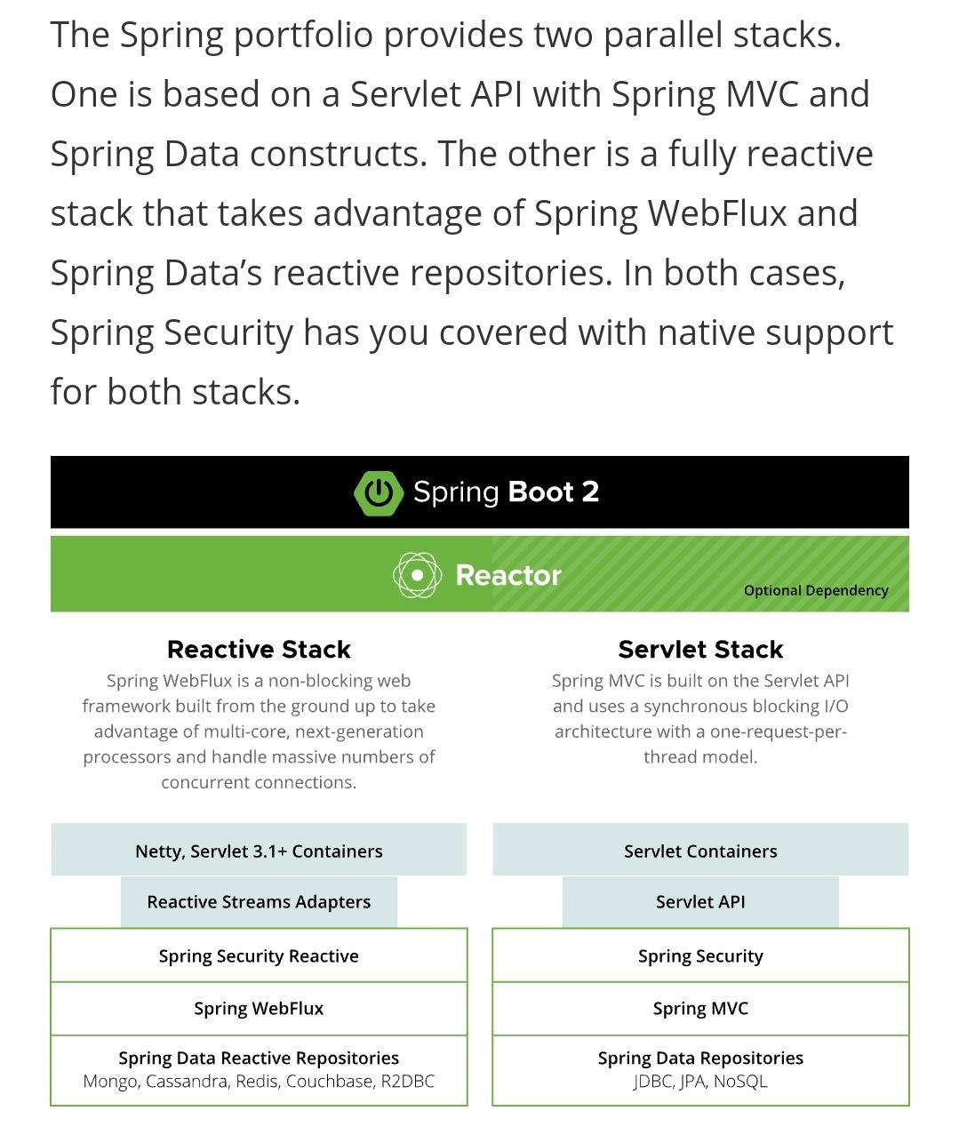
Reactive using Spring
Project Reactor is a fully non-blocking foundation with back-pressure support included. It's the foundation of the reactive stack in the Spring ecosystem and is featured in projects such as Spring WebFlux, Spring Data, and Spring Cloud Gateway.
Project Reactor and Spring WebFlux let developers take advantage of multi-core, next-generation processors—handling potentially massive numbers of concurrent connections. With reactive processing, you can satisfy more concurrent users with fewer microservice instances.

Slide 4
Reactive using other libraries and toolkits
RxJava
Vert.x
Akka

Slide 5
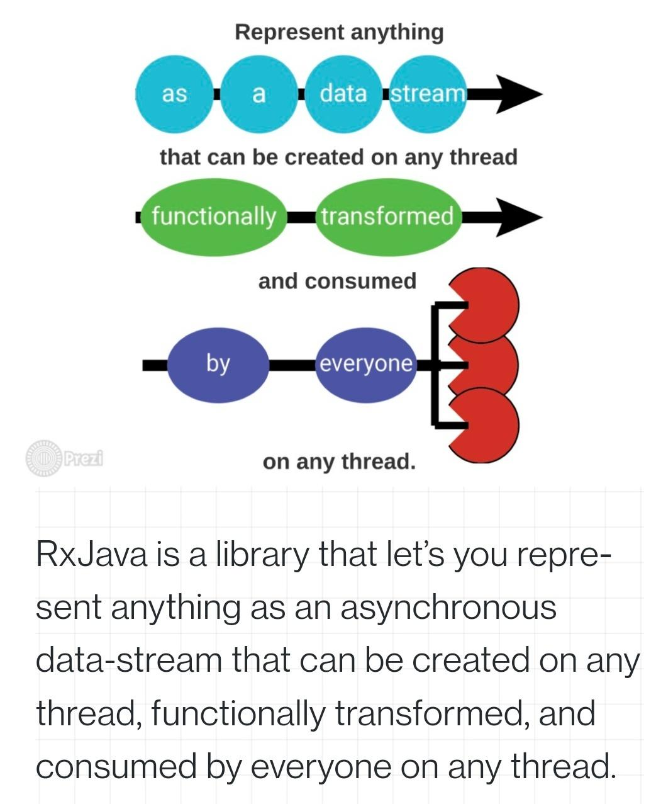
RxJava
RxJava is a Java VM implementation of Reactive Extensions: a library for composing asynchronous and event-based programs by using observable sequences.
It extends the observer pattern to support sequences of data/events and adds operators that allow you to compose sequences together declaratively while abstracting away concerns about things like low-level threading, synchronization, thread-safety and concurrent data structures.
RxJava features several base classes you can discover operators on:
Flowable: 0..N flows, supporting Reactive-Streams and backpressure
Observable: 0..N flows, no backpressure,
Single: a flow of exactly 1 item or an error,
Completable: a flow without items but only a completion or error signal,
Maybe: a flow with no items, exactly one item or an error.

Slide 6
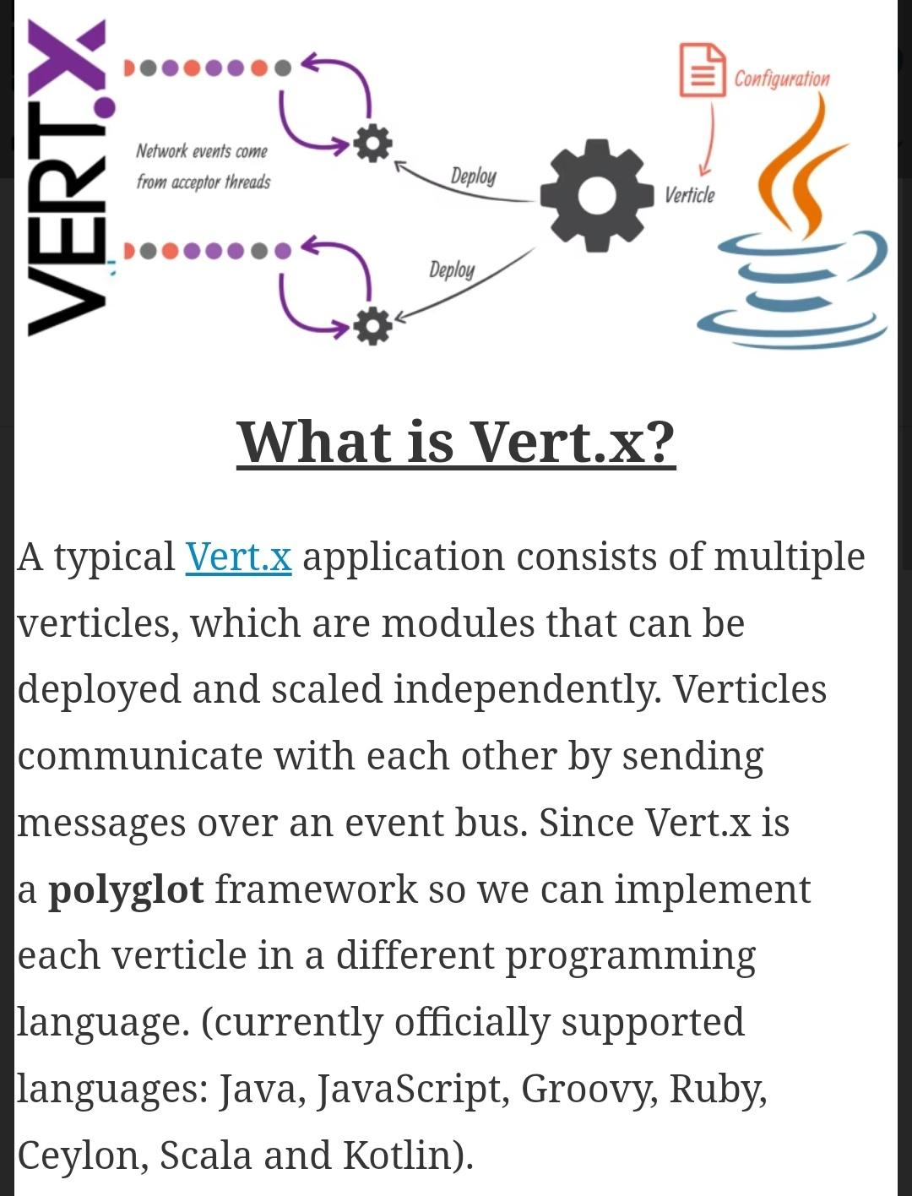
Vert.x
Vert.x comes with a simple, scalable, actor-like deployment and concurrency model out of the box that you can use to save you writing your own. To use this model, you write your code as set of verticles.
The Vert.x APIs are largely event driven. This means that when things happen in Vert.x that you are interested in, Vert.x will call you by sending you events.
None of the APIs in Vert.x block the calling thread.
Vert.x use futures to represent asynchronous results.

Slide 7
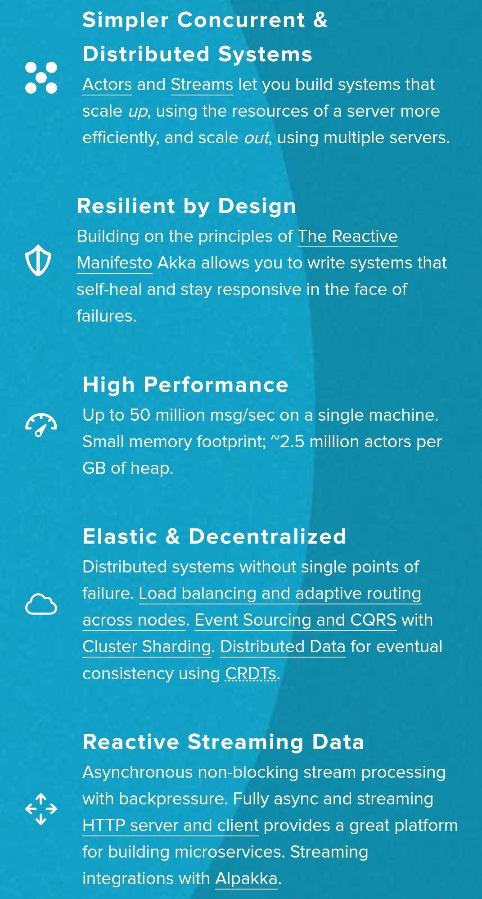
Akka
Akka is a toolkit for building highly concurrent, distributed, and resilient message-driven applications for Java and Scala.
Akka’s use of the actor model provides a level of abstraction that makes it easier to write correct concurrent, parallel and distributed systems. The actor model spans the full set of Akka libraries, providing you with a consistent way of understanding and using them.
Akka provides:
Multi-threaded behavior — without the use of low-level concurrency constructs like atomics or locks.
Transparent remote communication between systems and their components
Clustered, high-availability, elastic architecture, that scales on demand

Slide 8
References
https://spring.io/reactive
https://github.com/ReactiveX/RxJava
https://www.philosophicalhacker.com/2015/06/12/an-introduction-to-rxjava-for-android/
https://vertx.io/docs/vertx-core/java/
https://akka.io/
https://developer.lightbend.com/docs/akka-guide/index.html

